Slide 1
Islam
Chapter 12

Slide 2
Islam
Islam literally means “surrender” or “submission”
Follower of Islam is a Muslim, meaning “one who submits” to God
Holy language of Islam is Arabic
Apx 2.06 Billion Muslims worldwide, 2nd largest World Religion
And one of fastest growing religions
Much in common with Judaism and Christianity
All worship the God of Abraham and Moses
Belief in God’s revelations and Prophets (even accept Jesus Christ as a prophet)

Slide 3
Faith and Good Works
Judaism: Orthopraxy
Christianity: Orthodoxy
Islam: Both
Leads to activist and militaristic groups
Core Beliefs
Belief in One God – Allah
Belief in the Prophet – Muhammad
Belief in the Qur’an (Koran)
“God has promised those of you who believe and do good works to make them masters in the land…”
Qur’an 24:55

Slide 4
Muhammad Ibn Abdullah, the Founder of Islam
Serves both as God’s human instrument in bearing His revelation and
As the model or ideal whom all believers should emulate
Information regarding teachings and life of Muhammad come from the Qur’an and the hadiths
Source of Islamic law
Guidance on everything from hygiene, dress, eating, marriage, treatment of wives, etc.
The Hadith: Traditional report recording a saying or action of Muhammad
Sets Muhammad’s life and teaching as an example of how Muslims should act

Slide 5
Muhammad Ibn Abdullah, the Founder of Islam
Born in Mecca, Saudi Arabia in 570 a.d.
Orphaned at a young age, raised by an Uncle
Following family work, he became a merchant – Caravan work
Began to work for a wealthy widow named Khadijah, whom he later married
Together they had six children, though no male heir
After Khadijah’s death, Muhammad married several other women in polygamous marriages
Thirteen wives – to form political alliances and provide livelihood for widows
Four concubines
Most controversial is Aisha - marriage contracted at age 6, consummated at age 9 or 10

Slide 6
The Qur’an
Ancient Trade Cities center of thriving cross-cultural contact
At the age of 40, received vision of Angel Gabriel with writings which he was commanded to recite
Surah 96:1-5
Muhammad would continue to receive divine revelations over a period of 22 years, 610-632
Recitations first committed to memory; later written down and compiled according to length
Published as “The Qur’an” meaning the recitations

Slide 7
Themes of early prophetic message
Role of Muhammad as Last Prophet and Warner – admonish people to repent and obey God or suffer at Day of Judgement (see Surah 22:49-50; compare to Jewish prophets Jeremiah and Amos)
Only one God exists, Allah
Commands people to believe in this one God and to submit to God’s holy will
A day of judgment will come
Those submitted to God will be rewarded forever and others punished eternally
Generosity to the poor, widows, and orphans; presence and goodness of God in the natural world; and the prophetic call of Muhammad

Slide 8
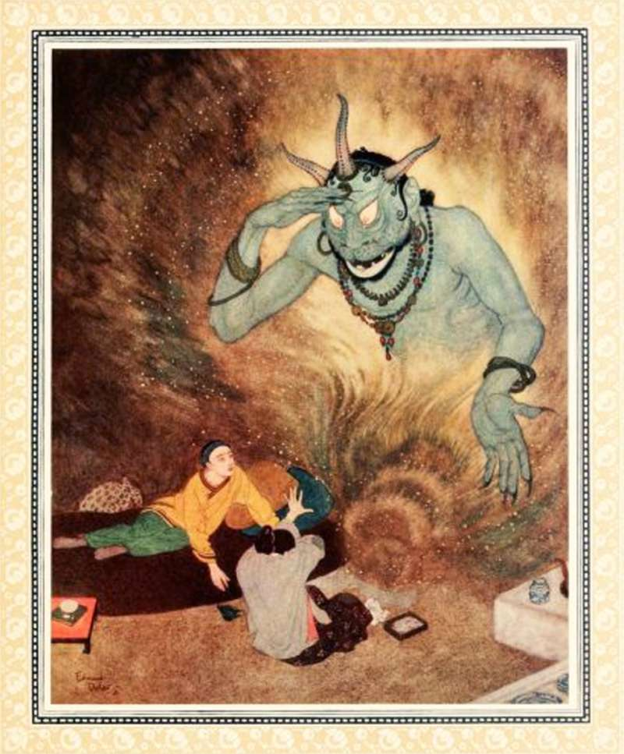
Pre-Islamic Arabian Religion
Tribal culture was polytheistic and animistic
Consisted of worship of tree and mountain spirits, and Jinn
Jinn and other demons retained in Islamic belief
supernatural creatures, shape-shifting otherworldly beings, jinn were spirits that haunted the deserts of Arabia. Their bodies are composed of fire. Jinn are not intrinsically malevolent—in some tales they grant wishes and give help to humans in need—but running afoul of an angry jinni is a hair-raising experience.

Slide 9
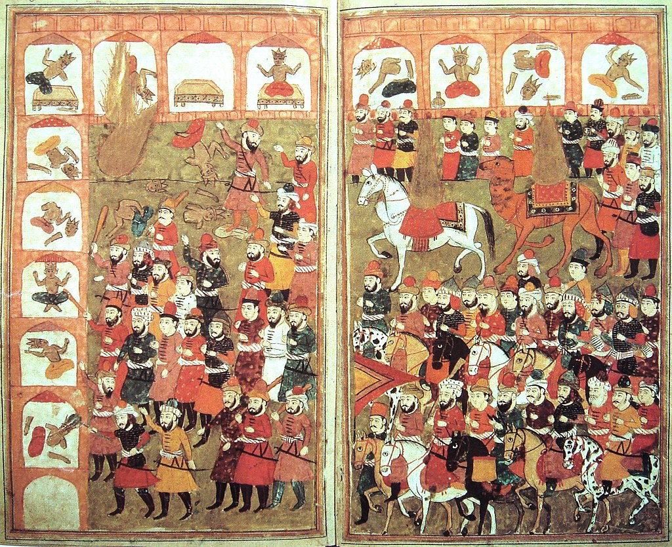
Spread of Islam
Muhammad begins preaching in Mecca
monotheism and the destruction idols
Denounced usury and other unscrupulous practices
All believers belong to a single universal community transcending tribal bonds
Teachings threatened the religious and economic foundations of Meccan society/undermined tribal authority
Ridiculed Muhammad as a deranged poet who had performed no signs or miracles
Persecution escalated and Muhammad’s position in Mecca deteriorated after the death of his uncle and Khadija in 619

Slide 10
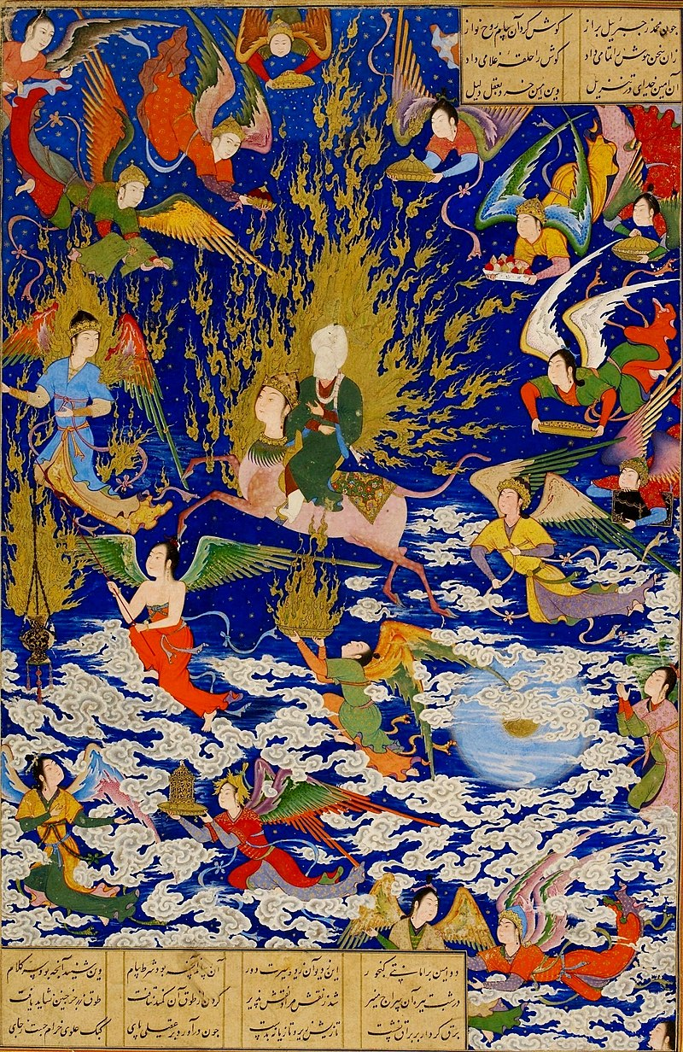
Night Journey (621 a.d.)
Gabriel awakens Muhammad and purifies him
Riding a Buraq (mythical winged creature) Muhammad is taken to Jerusalem where he meets Abraham, Moses, and Jesus
He officiates in prayer – establishing his primacy among God’s messengers
From there he ascends all seven levels of heaven until he reaches the throne of God
He is commanded to pray 50 times a day, but Moses advises Muhammad to plead for a reduction to five

Slide 11
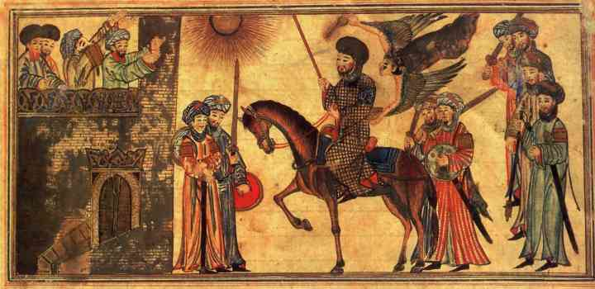
The Hijrah (622 a.d.)
Muhammad and his followers forced to flee Mecca
Known as Hijrah (migration or flight) – central event in early Islamic history
Muhammad’s message favorably received in Medina
Islam took on political form with the establishment of the Islamic community-state (Umma)
Islam begins to be institutionalized
Islamic calendar start with this date
a.h. 1
Follow lunar calendar
AD 2022 = AH 1444

Slide 12
Life of Muhammad
Episode 2 “Holy Wars”
Notes:
Amazon prime, start at about 20 minutes in

Slide 13
Muhammad Ibn Abdullah, the Founder of Islam
Muslims organized raids on Meccan caravans
Continued until the Muslim military victory over Mecca in the Battle of Badr (624)
Turning point in the fortunes of Islam
Many Arab tribes converted to Islam while Muhammad controlled Medina
Gained control of Mecca in 630 C.E.
Removed idolatrous images from the city, leaving only the sacred cubic building and its holy stone
Kept Mecca as the destination for Muslim pilgrimage and maintained some of its religious sites

Slide 14
Muhammad Ibn Abdullah, the Founder of Islam
Raised armies to conquer the northern regions of Arabian peninsula, taking on the Christian Byzantine Empire
Died in Medina in 632
Without a male heir and without naming a successor (or caliph)
Caliph would lead the community in its political and religious life

Slide 15
Islam Immediately Following the Death of Muhammad (632-661)
Without a designated successor, Islam plunged into political and religious crises
Note: State and Religion joined – so successor would be both religious and political leader
Islam soon divided into Shia (Shiite) and Sunna (Sunni)
After a period of uncertainty, a Caliph was selected
Caliphate traditionally divided into three periods:
The Rightly Guided Caliphs (632-661)
The Umayyad Empire (661-750)
Abbasid Empire (750-1258)

Slide 16
Rightly Guided Caliphs
First four Caliphs were all original companions of the Prophet
Abu Bakr selected as first Caliph
Muhammad had appointed him to be the leader of the Friday prayer service in his absence
Although not considered a prophet, he had great religious prestige
Wars of Apostacy
Tribal pacts began to unravel
Abu Bakr put down revolts militarily
Consolidated Muslim rule over entire peninsula
Died after only two years, succeeded by Umar ibn al-Khattab

Slide 17
Rightly Guided Caliphs
Umar ibn al Khattab
Military man, added “commander of the faithful” to his titles
Established a process to choose caliph (selection committee)
Uthman ibn Affan from Umayyad clan selected as 3rd Caliph
Leading Meccan family and early enemy of the Prophet
Many resented the Caliph being selected from this clan
Uthman assassinated in 656, begins series of murders and rebellions that plague early development of Islam

Slide 18
Rightly Guided Caliphs
Ali ibn Abi Talib selected as 4th Caliph
Cousin and son-in-law to the Prophet, first male convert to Islam
Many of his supporters believed leadership should remain in family of Muhammad
Belief that Muhammad had actually designated Ali as rightful successor, but was denied his rightful inheritance by the first three Caliphs
Supporters of Ali become known as Shia

Slide 19
Rightly Guided Caliphs
Two civil wars, both on pretext that Ali failed to find and prosecute the assassins of Uthman
First one led by Aisha, Muhammad’s youngest wife
Crushed at the “Battle of the Camel” – so called because the battle took place around the camel that Aisha was riding
Second one led by Muawiyah, a relative of the Umayyad clan
Soldiers begged for arbitration by placing the Quran on their swords
Arbitration left Muawiyah as governor of Syria, then extended rule into Egypt
A group critical of Ali for failing to punish Muawiyah assassinates him in 661

Slide 20
Rightly Guided Caliphs
Muawiya assumes religious authority; transfer power to Damascus beginning Umayyad Dynasty
Frustrated belief that leadership should remain with Muhammad’s family gives rise to schism
Shia – minority branch of Islam which holds that Muhammad’s genuine successors descended from his son-in-law Ali
Sunna – majority branch of Islam which holds that genuine succession from Muhammad did not depend on hereditary descent from his son-in-law
From earliest time, Islam linked to political authority – now Islam linked to Empire
Caliphate becomes absolute monarchy with political, military, judicial, fiscal, and religious control over the various conquered peoples

Slide 21
Umayyad Dynasty
Nature of Empire is expansion – By the time Muawiyah seized power, Muslims had already spread to: Egypt, Libya, the Fertile Crescent, Syria, Iraq, and Persia
Under the Umayyad Dynasty, Muslims conquered the Maghreb (North Africa), the Iberian Penninsula, extended into the Indian Subcontinent and threatened Europe until they were halted in France at the Battle of Tours in 732

Slide 22
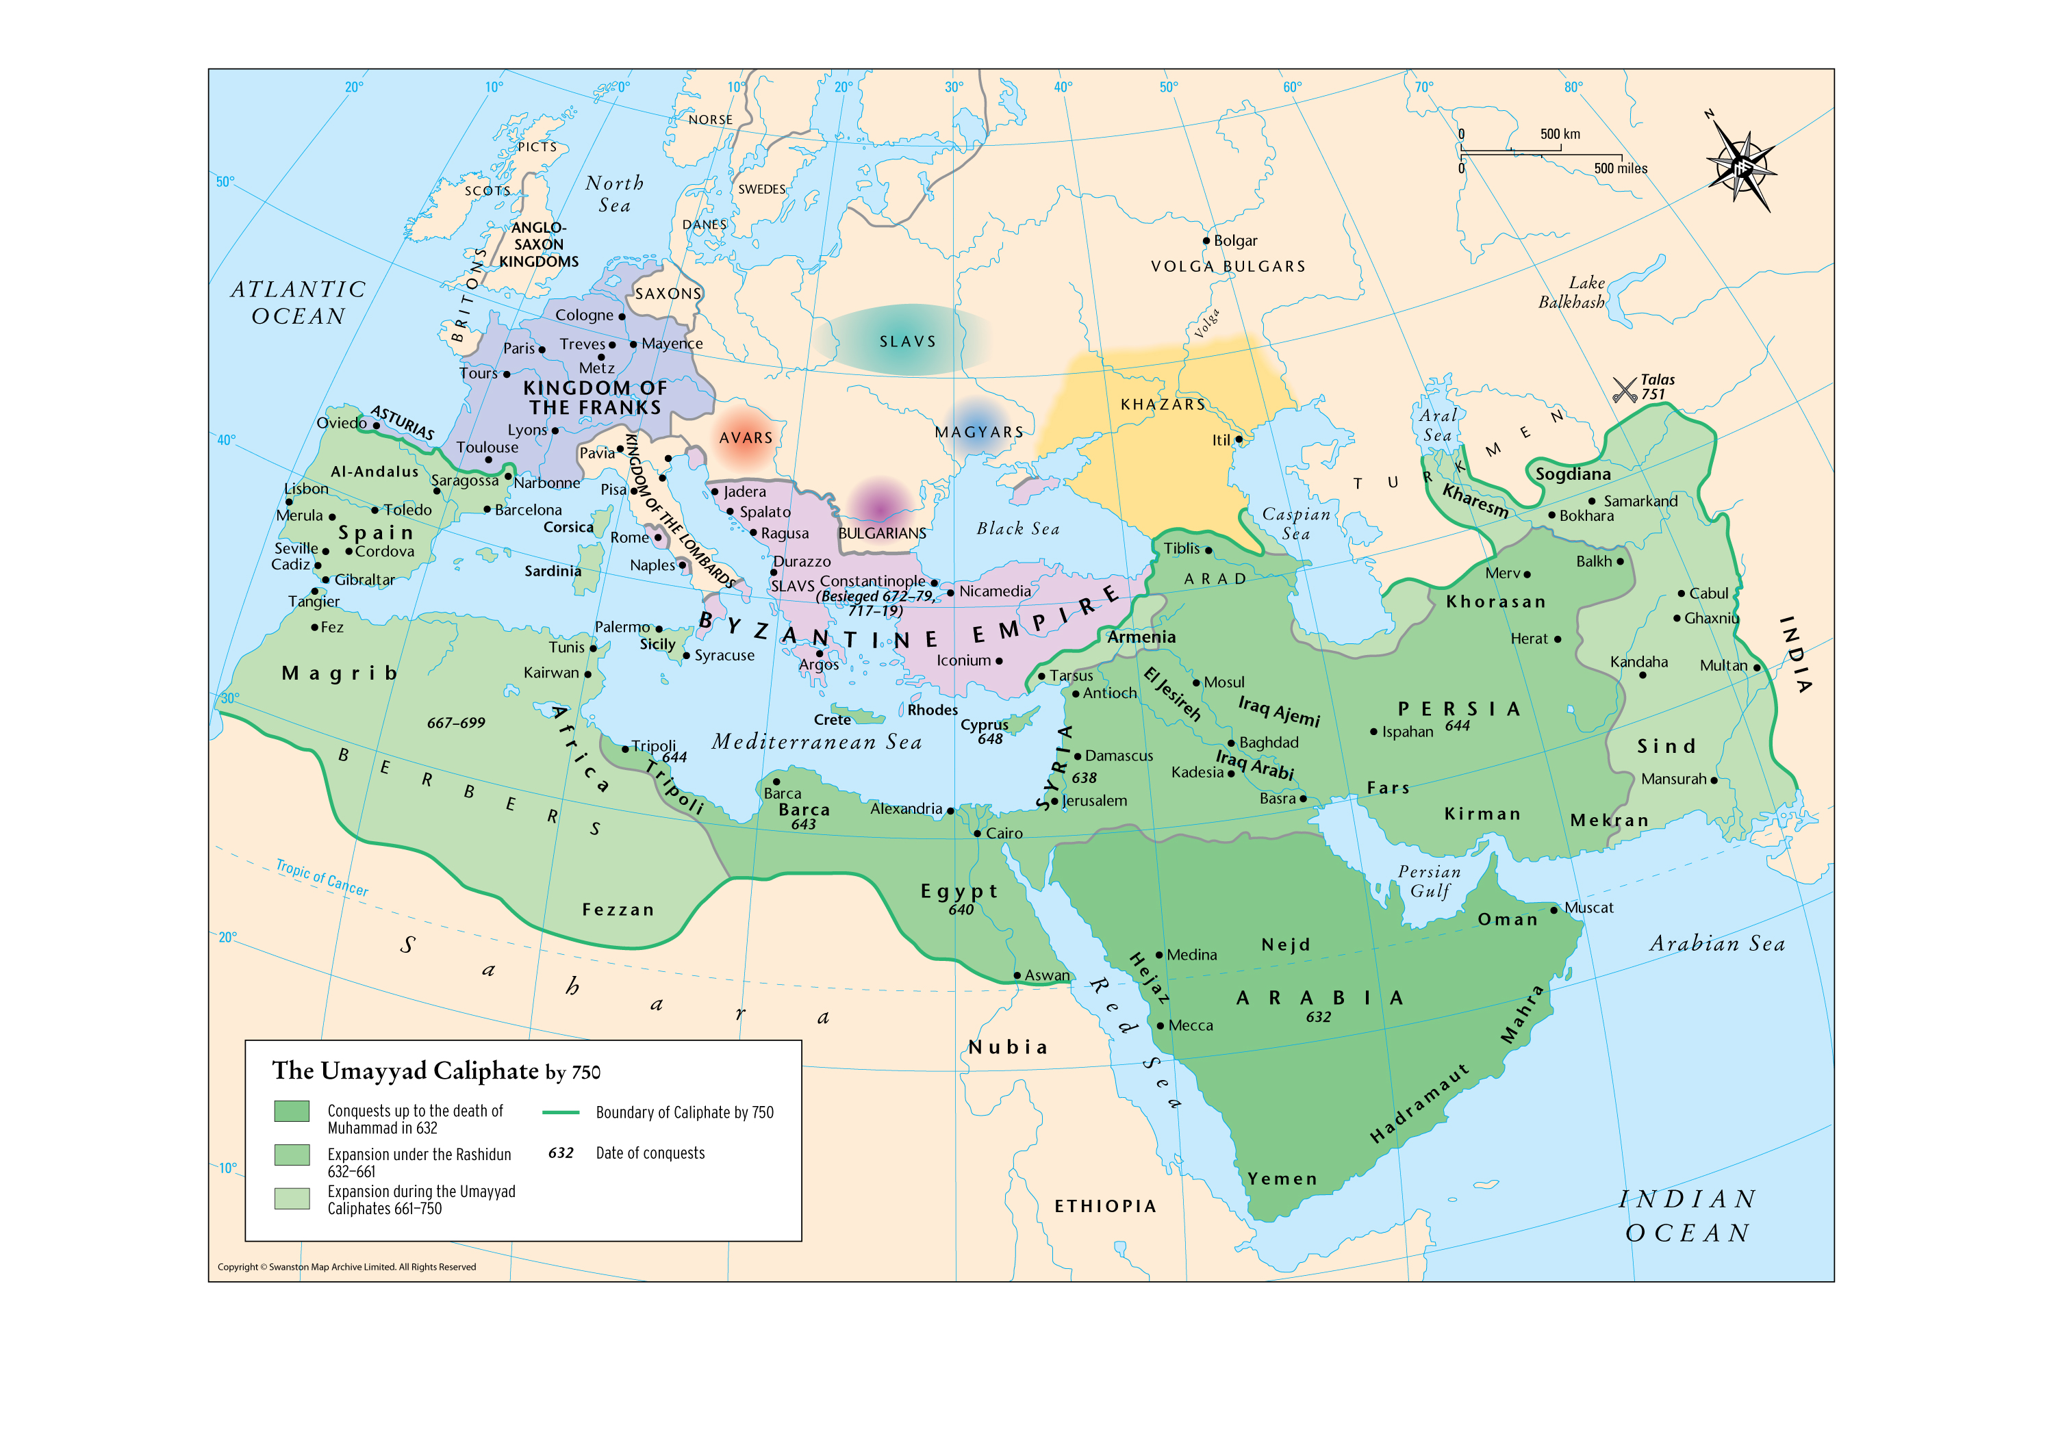

Slide 23
Umayyad Dynasty
Nature of Empire is expansion – By the time Muawiyah seized power, Muslims had already spread to: Egypt, Libya, the Fertile Crescent, Syria, Iraq, and Persia
Under the Umayyad Dynasty, Muslims conquered the Maghreb (North Africa), the Iberian Penninsula, extended into the Indian Subcontinent and threatened Europe until they were halted in France at the Battle of Tours in 732
Sunni leadership belonged to Umayyad tribe from 661 to 750 C.E.
Remained united for two centuries after Muhammad’s death

Slide 24
Umayyad Dynasty
Arabic Muslims given preferential treatment; non-Arabic Muslims and the dhimmi were treated as second class citizens
A revolutionary movement arose, the dynasty fell and Abu al-Abbas, a descendant of the Prophet’s uncle was declared Caliph
The capital moved to Baghdad establishing the Abbasid Caliphate
Dhimmi: Jewish and Christian communities living under Muslim rule

Slide 25
Abbasid Caliphate
Abbasids used Islam to legitimize power – great patrons of Islam
Emergence of Islamic scholarship, mosques, and schools
Syrian influence replaced by Persian
Caliphate took on court etiquette of a Persian Emperor
Enormous wealth allowed them to be generous patrons of arts and culture
Shariah (Islamic Law) more effectively instituted
The Ulema (specialist in Islamic law and theology) become religious elite
Arabic displaced local languages; world literature translated into Arabic

Slide 26
Abbasid Caliphate
Abbasid rule ended when the Turks took power over Arab rule
Turks lost possession of Palestine during the Crusades
Muslims conquered Constantinople, and Turkish Muslim control spread to India
Ottoman Turks took over the empire of Islam (1300–1923), but it collapsed after World War I

Slide 27
History of Islam
From the Death of Muhammad to the Abbasid Caliphate
Notes:
Slide 1: Title Slide
Title: "History of Islam: From the Death of Muhammad to the Abbasid Caliphate"
This title encapsulates the timeline and scope of our exploration, focusing on a pivotal era in Islamic history, where foundational political, religious, and cultural developments occurred.
Introduction
Background Context:
Islam originated in the Arabian Peninsula in the 7th century, with Muhammad as its prophet and leader. His death in 632 CE marked the end of direct prophetic guidance and the beginning of new challenges for the nascent Muslim community.
The subsequent period saw the establishment of the Caliphate, a leadership institution that combined religious and political authority, shaping Islamic governance and society.
Why This Period Matters:
The years following Muhammad's death were marked by rapid territorial expansion, internal power struggles, and the emergence of theological differences.
The development of institutions like the Caliphate and cultural achievements under the Abbasids laid the foundation for Islamic civilization’s lasting influence.
Key Focus
Understanding the Transition from Prophetic Leadership to Caliphal Rule:
Muhammad's role encompassed spiritual leadership, judicial authority, and political governance. His death created a leadership vacuum, leading to debates about succession.
The Caliphate was established to maintain unity and ensure the continued spread of Islam, evolving into a sophisticated institution.
Highlighting Key Eras:
Rightly Guided Caliphs (632–661): The formative years when companions of the Prophet governed, solidifying Islamic rule and addressing early divisions.
Umayyad Dynasty (661–750): Marked by imperial expansion and administrative centralization, but also by growing dissatisfaction and inequality.
Abbasid Caliphate (750–1258): A golden age of culture, science, and scholarship, where Islamic civilization reached its zenith.
Talking Points
Islam’s Evolution:
Transition from a single religious community under Muhammad to a vast empire.
The interplay between religion and politics that defined early Islamic governance.
Division and Unity:
The emergence of theological schisms like Sunni and Shia, which began as political disputes over leadership but evolved into distinct sectarian identities.
Despite divisions, the shared religious framework and Sharia law created a unifying cultural and legal system.
Cultural and Historical Legacy:
This period shaped the intellectual, cultural, and spiritual trajectory of the Islamic world.
The Abbasids' patronage of arts and sciences left a lasting global legacy.
Suggestions for Engagement:
Ask Students: Why do you think the transition from religious to political leadership is so challenging in any society? How do you see the intertwining of religion and governance reflected in modern states?
Activity Idea: Create a timeline of leadership transitions discussed in the lecture to visualize continuity and change.
Let me know when you'd like to proceed to Slide 2!

Slide 28
After Muhammad's Death (632-661)
Crisis of Succession:
No designated successor;
political and religious uncertainty.
Division of Islam:
Shia (family leadership) vs. Sunni (non-hereditary leadership).
Caliphate Periods:
Rightly Guided Caliphs (632-661)
Umayyad Dynasty (661-750)
Abbasid Empire (750-1258)
Notes:
Slide 2: After Muhammad's Death (632-661)
Crisis of Succession:
Background: Muhammad did not name a successor, nor did he leave explicit instructions on how leadership should be determined. This created a leadership vacuum in the Muslim community, which combined political and religious authority.
Key Issue: The absence of a succession plan led to debates over who should lead, with opinions divided between those advocating for familial leadership and others prioritizing the most capable companion.
Historical Significance: This crisis set the stage for the eventual division between Sunni and Shia Islam, which persists to this day.
Division of Islam:
Shia (Shiites): Believed leadership should remain within Muhammad’s family, specifically through his cousin and son-in-law, Ali ibn Abi Talib. They argued that Muhammad had designated Ali as his successor.
Sunni: Believed that leadership should be based on the consensus of the Muslim community and not limited to Muhammad’s family. They supported selecting a leader from among Muhammad’s closest companions.
Impact: These differing views on leadership evolved into theological and cultural differences, creating two distinct branches of Islam.
Caliphate Periods:
Rightly Guided Caliphs (632–661):
A formative period when close companions of Muhammad ruled. Their leadership was characterized by attempts to consolidate and expand the Muslim community.
Marked by internal conflicts, wars of apostasy, and the beginnings of administrative and religious structures.
Umayyad Dynasty (661–750):
Transitioned the leadership into a dynastic monarchy. Their era was defined by military conquests, administrative centralization, and tensions between Arab and non-Arab Muslims.
Abbasid Caliphate (750–1258):
Represented the cultural and intellectual zenith of the Islamic world. They embraced Persian influences, established Baghdad as a cultural hub, and nurtured advancements in science, philosophy, and literature.
Let me know when you're ready for Slide 3!

Slide 29
Rightly Guided Caliphs (632-661)
Abu Bakr:
Unified Arabian Peninsula;
Wars of Apostasy.
Umar ibn al-Khattab:
Expanded territory; extended Muslim rule into Syria, Egypt, and Persia
leadership selection process through a council
Notes:
Slide 3: Rightly Guided Caliphs (632-661)
Abu Bakr:
Role: First Caliph, chosen shortly after Muhammad’s death, was a close companion of the Prophet and highly respected among the Muslim community.
Leadership Achievements:
Wars of Apostasy: Faced revolts from tribes who renounced Islam after Muhammad’s death, leading to military campaigns to reunify the Arabian Peninsula under Islamic rule.
Consolidation: Stabilized the young Muslim community, ensuring that Islamic practices and teachings remained unified.
Legacy: His brief two-year rule laid the foundation for the administrative and military organization of the Muslim state.
Umar ibn al-Khattab:
Role: Second Caliph, known for his strong leadership and significant territorial expansions.
Leadership Achievements:
Military Expansion: Initiated campaigns that extended Muslim rule into Syria, Egypt, and Persia, establishing Islam as a major political power.
Governance: Introduced administrative reforms, including a process for selecting future caliphs through a council, which helped structure early Islamic governance.
Title: Added “Commander of the Faithful” to emphasize the Caliph's dual religious and political authority.
Uthman ibn Affan:
Role: Third Caliph, from the powerful Umayyad clan, which caused discontent among some factions within the Muslim community.
Leadership Achievements:
Standardization of the Quran: Commissioned an official version of the Quran, ensuring consistency in Islamic teachings and preventing sectarian disputes over its content.
Challenges: His rule faced growing opposition due to perceptions of favoritism toward his Umayyad relatives.
Assassination: His death in 656 triggered widespread unrest and set the stage for internal divisions within the Muslim community.
Ali ibn Abi Talib:
Role: Fourth Caliph, cousin, and son-in-law of Muhammad, and a central figure in early Islamic history.
Leadership Achievements:
Civil Wars: His rule was marked by internal strife, including the Battle of the Camel (against Muhammad’s widow, Aisha) and conflicts with Muawiyah, governor of Syria.
Shia Support: Many of his followers believed he was Muhammad’s rightful successor, leading to the formal division between Sunni and Shia Muslims.
Assassination: Ali’s death in 661 ended the era of the Rightly Guided Caliphs, ushering in the Umayyad Dynasty.
Let me know when you'd like to proceed to Slide 4!

Slide 30
Rightly Guided Caliphs (632-661)
Uthman ibn Affan:
Umayyad clan; assassination triggered instability.
Ali ibn Abi Talib:
Muhammad’s cousin/son-in-law;
civil wars;
Shia-Sunni split.
Notes:
Slide 3: Rightly Guided Caliphs (632-661)
Uthman ibn Affan:
Role: Third Caliph, from the powerful Umayyad clan, which caused discontent among some factions within the Muslim community.
Leadership Achievements:
Standardization of the Quran: Commissioned an official version of the Quran, ensuring consistency in Islamic teachings and preventing sectarian disputes over its content.
Challenges: His rule faced growing opposition due to perceptions of favoritism toward his Umayyad relatives.
Assassination: His death in 656 triggered widespread unrest and set the stage for internal divisions within the Muslim community.
Ali ibn Abi Talib:
Role: Fourth Caliph, cousin, and son-in-law of Muhammad, and a central figure in early Islamic history.
Leadership Achievements:
Civil Wars: His rule was marked by internal strife, including the Battle of the Camel (against Muhammad’s widow, Aisha) and conflicts with Muawiyah, governor of Syria.
Shia Support: Many of his followers believed he was Muhammad’s rightful successor, leading to the formal division between Sunni and Shia Muslims.
Assassination: Ali’s death in 661 ended the era of the Rightly Guided Caliphs, ushering in the Umayyad Dynasty.
Let me know when you'd like to proceed to Slide 4!

Slide 31
The Rise of Muawiyah and the Founding of the Umayyad Dynasty
Assassination of Ali (661):
Ali was assassinated by the Kharijites, a radical group dissatisfied with his leadership. This marked the end of the Rightly Guided Caliphate and ushered in a new era of Islamic governance.
Muawiyah I’s Ascension (661):
After Ali’s death, Muawiyah, governor of Syria and a member of the powerful Umayyad clan, claimed leadership.
Significance of Muawiyah's Rule:
He negotiated with Hasan ibn Ali, Ali’s son and the Prophet’s grandson, to abdicate in exchange for peace and a promised return to elective leadership. However, Muawiyah established hereditary succession, breaking from this agreement.
Notes:
Transition from Rightly Guided Caliphs to the Umayyad Dynasty
The End of the Rightly Guided Caliphate
Ali ibn Abi Talib's Leadership (656–661):
Ali, the fourth and final of the Rightly Guided Caliphs, faced significant opposition during his reign.
Key Conflicts:
First Civil War (Battle of the Camel, 656): Fought against forces led by Aisha, Muhammad’s widow, accusing Ali of failing to punish Uthman’s assassins.
Second Civil War (656–661): Fought against Muawiyah, governor of Syria and a relative of Uthman. Ali’s failure to fully defeat Muawiyah led to further divisions.
Assassination of Ali (661):
Ali was assassinated by the Kharijites, a radical group dissatisfied with his leadership. This marked the end of the Rightly Guided Caliphate and ushered in a new era of Islamic governance.
The Rise of Muawiyah and the Founding of the Umayyad Dynasty
Muawiyah I’s Ascension (661):
After Ali’s death, Muawiyah, governor of Syria and a member of the powerful Umayyad clan, claimed leadership.
Significance of Muawiyah's Rule:
He negotiated with Hasan ibn Ali, Ali’s son and the Prophet’s grandson, to abdicate in exchange for peace and a promised return to elective leadership. However, Muawiyah established hereditary succession, breaking from this agreement.
Reasons for Umayyad Dominance:
Strategic Power Base: As governor of Syria, Muawiyah had consolidated military and political control over a key region.
Support from Tribal Alliances: The Umayyads, one of the most influential clans in Mecca, leveraged their tribal networks to gain widespread support.
Experience in Governance: Muawiyah was a capable administrator, having effectively ruled Syria for decades.
Key Features of the Transition
Shift from Religious to Dynastic Rule:
The transition marked the end of the consultative, community-focused leadership of the Rightly Guided Caliphs.
The Caliphate became a hereditary monarchy under Umayyad control, focusing on political power and territorial expansion.
The spiritual authority of the Caliphate diminished, with increasing power given to local religious leaders (ulema).
Capital Relocation to Damascus:
By moving the capital from Medina to Damascus, Muawiyah signaled a shift away from the traditional centers of Islamic faith toward a more politically strategic location.
Damascus allowed for closer oversight of the empire’s expanding territories and administrative resources.
Emergence of the Sunni-Shia Divide:
The rise of the Umayyads exacerbated tensions between the Sunni majority, who accepted Muawiyah’s rule, and the Shia minority, who believed that only descendants of Muhammad (through Ali and Fatimah) were the rightful leaders.
This division, rooted in the events of this transition, remains one of the most significant splits in Islamic history.
Early Challenges for the Umayyad Dynasty
Maintaining Unity: The Umayyads had to balance governing a rapidly growing empire with the dissatisfaction of many Muslims who felt the dynasty had strayed from Islamic ideals.
Opposition from the Kharijites: Radical Islamic groups like the Kharijites rejected both Ali’s and Muawiyah’s leadership, challenging Umayyad authority.
Criticism of Hereditary Succession: Many viewed hereditary rule as a betrayal of the egalitarian and consultative principles of early Islam.
Consolidation of Power
Muawiyah’s Diplomatic Skill:
He managed to bring stability to a divided Muslim community by emphasizing unity and ensuring loyalty from provincial governors and military commanders.
Institutional Development:
Introduced systematic taxation and administration, modeled in part on Byzantine and Persian practices.
Strengthened the military to support further expansion and suppress internal dissent.
This period represents a crucial turning point in Islamic history, shifting from the early ideals of a religiously led community to the pragmatism of empire-building under dynastic rule. Let me know if you'd like to explore further details!

Slide 32
Umayyad Dynasty (661-750)
Capital at Damascus; Islam became an empire.
Expansion:
North Africa, Iberian Peninsula, parts of India; Battle of Tours (732).
Inequality:
Arab Muslims favored;
dhimmi (Jews, Christians) as second-class citizens.
Decline:
Revolution led to Abbasid rise.
Notes:
Slide 4: Umayyad Dynasty (661–750)
Capital at Damascus:
Historical Shift: The relocation of the capital from Medina to Damascus marked a transition from the early Islamic period to a more centralized imperial rule.
Significance: Damascus’s location allowed for better administrative control over the vast and expanding Islamic territories, with a focus on governance rather than religious leadership.
Islam Became an Empire:
Political Transformation: The Umayyad Caliphate introduced hereditary succession, transitioning the Caliphate into a dynastic monarchy.
Governance: The Caliphate held absolute control over political, judicial, fiscal, and military matters, further intertwining religion with state power.
Expansion of Territory:
Regions Conquered:
North Africa and the Iberian Peninsula (Spain and Portugal), reaching as far as the Pyrenees.
Extended influence into Central Asia and the Indian subcontinent.
Key moment: The Battle of Tours (732) in France, where Muslim expansion into Europe was halted by Frankish forces under Charles Martel.
Cultural Integration: Conquests brought diverse populations under Muslim rule, including Christians, Jews, and Zoroastrians.
Inequality Under Umayyad Rule:
Preferential Treatment: Arab Muslims were favored, receiving greater political, social, and economic privileges compared to non-Arab Muslims (mawali) and non-Muslim communities (dhimmi).
Dhimmi Status: Jews and Christians, as "People of the Book," were protected but faced restrictions, including paying a special tax (jizya) and being excluded from key positions of power.
Decline of the Dynasty:
Revolutionary Movements: Dissatisfaction with Umayyad policies, especially the inequality between Arab and non-Arab Muslims, led to unrest.
Abbasid Revolution: The Umayyads were overthrown in 750 CE by the Abbasids, who claimed descent from Muhammad’s uncle and promised a more inclusive rule.
Let me know when you're ready for Slide 5!

Slide 33
Abbasid Caliphate (750-1258)
Cultural Flourishing: Persian influences; support for arts and scholarship.
Legal and Religious Development: Sharia law; Ulema as religious elite.
Golden Age: Arabic as a unifying language; intellectual progress.
Decline: Ended with Turkish and Mongol incursions; Ottoman Turks took over.
Notes:
Slide 5: Abbasid Caliphate (750–1258)
Cultural Flourishing:
Persian Influence:
The Abbasids incorporated Persian traditions into governance, adopting courtly customs that elevated the Caliph’s role to that of an emperor.
This Persianization marked a departure from the Arab-centric policies of the Umayyads, promoting inclusivity among different ethnic groups.
Support for Arts and Scholarship:
The Abbasids were patrons of knowledge, establishing institutions like the House of Wisdom in Baghdad, where scholars translated Greek, Persian, and Indian texts into Arabic.
Advances in astronomy, medicine, mathematics (notably algebra), and philosophy flourished under their reign.
Legal and Religious Development:
Sharia Law: The Abbasids played a crucial role in formalizing Islamic law, integrating it deeply into governance and daily life.
Role of the Ulema: Specialists in Islamic law and theology (ulema) emerged as religious elites, interpreting Sharia and maintaining its application across the empire.
Unity through Religion: By emphasizing Islamic law and scholarship, the Abbasids created a unifying framework across their diverse and sprawling empire.
Golden Age of Arabic Culture:
Arabic as a Lingua Franca: Arabic became the common language of administration, scholarship, and culture, fostering communication across the empire.
Global Knowledge Exchange: Scholars of various faiths collaborated, translating works from Greek (e.g., Aristotle and Plato), Sanskrit (e.g., Hindu texts), and Persian.
Literary Achievements: Iconic works such as "The Thousand and One Nights" reflect the cultural synthesis of the Abbasid period.
Decline of Abbasid Rule:
Fragmentation and Invasions:
The Abbasid Caliphate’s vast territory became difficult to govern, leading to the rise of autonomous regions and local rulers.
Invasions by Seljuk Turks, Crusaders, and ultimately the Mongols weakened Abbasid authority.
End of Abbasid Rule:
The Mongols sacked Baghdad in 1258, marking the end of the Abbasid Caliphate. However, Abbasid cultural and intellectual contributions endured beyond their political demise.
Let me know if you'd like further elaboration or additional context for any of these points!

Slide 34
Essential Teachings of Islam
God is One
Muslims are strict monotheists -- Teaching that there is only one God forms the basis and the center of the religion
Arabic word for God is Allah (compare El in Hebrew)
God has a central role in the religion of Muslims and Islamic countries
Called to prayer (adhan or azan) 5 times a day by a Muazzin

Slide 35

Call to Prayer (Azan)

Slide 36
Essential Teachings of Islam
Angels and spirits
Created by God to serve God and humans
Muhammad received the Qur’an through the archangel Gabriel
Prophets
The Qur’an states that God has revealed the divine will at key points in human history through prophets
All the prophets call for submission to the will of God and preparation for an impending judgment
Muhammad is the culmination and conclusion of the entire line of prophets

Slide 37
Essential Teachings of Islam
Final Judgment
God will judge people by how they submitted to God’s will
Those who submit to God’s will enter heaven, and those who don’t go to hell

Slide 38
Worship – The Five Pillars of Islam
Shahada (Creed): Fundamental confession of faith
There is no god but God, and Muhammad is God’s prophet
Salat (Prayer):
Each Muslim says the ritual prayers, salat, five times a day
Mosque: Building for formal Muslim worship
When women pray in the mosque, they are out of the men’s sight
Worshippers pray in straight lines facing the direction of Mecca
One’s body is active in prayer, and the actions represent submission to God

Slide 39
Worship – The Five Pillars of Islam
Sawm (Fasting) –
Muslims are required to observe fasting during the daylight hours of Ramadan
No food, drink, or sexual intercourse is allowed during daylight
Celebration of Eid al-Fitr marks the end of Ramadan
Zakat (Almsgiving)
The Qur’an urges all Muslims to give generously to the poor
Shari’a made generosity a formal obligation with specific rules
Pilgrimage to Mecca (hajj)
All Muslims are required to participate in official pilgrimage to Mecca at least once in his or her lifetime

Slide 40
Jihad
Often referred to as the “6th pillar” though does not have official status as such
Jihad comes out quite clearly and often in the Quran
Struggle – as individuals and community to realize God’s will, to lead virtuous lives, and to extend Islam through preaching and education
Struggle – military struggle to defend or extend Islam through force of arms
Quran repeatedly commands Muslims to take up arms and fight when necessary on behalf of the community

Slide 41
Islamic Ethics and Religious Practices
Marriage and Sexuality
Muhammad taught that celibacy is unnatural – no tradition of celibate monasticism or clergy
Sex is limited within bonds of matrimony or with one’s slaves (24:33)
A man may have up to four wives at one time as long as he provides for them equally and with separate living quarters
Quran admonishes modesty for both men and women (24:30-31)
Disagreement among Muslims how this is to be interpreted; not all Muslim women wear hijab

Slide 42
Islamic Ethics and Religious Practices
Dietary Restrictions
Only halal foods may be eaten by Muslims
Halal: Permitted foods and actions
Foods that are haram may not be eaten
Haram: Forbidden foods and actions, such as pork
Drinking of wine is prohibited by the Qur’an

Slide 43
Islamic Ethics and Religious Practices
Gambling and Usury Restricted
Circumcision – not mentioned in the Quran, but Muhammad stated that circumcision was a “law for men”
Preferred age is often seven, though varies depending on country
Some Muslim countries, mostly in Africa, practice female “circumcision” – known as female genital mutilation (FGM)

Slide 44

Female Genital Mutilation
Notes:
https://www.youtube.com/watch?v=sIwQLgHHOZQ

Slide 45
FGM & Islam
Primarily cultural; not found in the Qur’an
Linked to Islam due to its focus on female chastity and seclusion
Praised in the Hadith as being noble but not required
Considered obligatory by some sects of Islam (shafi’i)
Widespread belief among Muslims that FGM is religious obligation

Slide 46
Influential Muslim Groups
Sufis
Followers of Islamic mystical movement Sufism

Slide 47
Influential Muslim Groups
Sufis
Followers of Islamic mystical movement Sufism
Whirling Dervish

Slide 48
Influential Muslim Groups
Sufis
Followers of Islamic mystical movement Sufism
Whirling Dervish
Wahhabi
Modern Sunni radical movement begun by Muhammad al-Wahhab
Muslim Brotherhood
Conservative religious and political movement founded in 1929

Slide 49
Influential Muslim Groups
Taliban
Students of the Qur’an, a radical Sunni group in Afghanistan
Considers Muslims who don’t adhere to their strict attitudes and standards of behavior to be false Muslims and enemies of Islam
The Islamic State (IS)
Formerly known as The Islamic State of Iraq and the Levant (ISIL) and The Islamic State of Iraq and Syria (ISIS)
Tries to conquer and hold territory
Ferocious in applying its interpretation of Muslim law to its territories

Slide 50
Influential Muslim Groups
Al-Qaeda, founded by Osama bin Laden, launched coordinated attacks on the United States
Bin Laden expressed strong opposition to Westernization of Muslim lands and the presence of the Jewish state of Israel

